Slide 1


ENGEERING GRAPHICS AND INTRODUCTION TO DIGITAL FABRICATION
COURSE CODE : BME01T1001.
Session :2021-22
SEMESTER:02

Slide 2
TOPIC: HEX TAPPING BOLT Submitted by : SUBMITTED TO:LAV PREET SIR;
ADITIYA PRAJAPATI: 21SCSE1420051
PRATEEK KR. SINGH: 21SCSE1010884
INTRODUCTION:
What is hex tap bolt?
Hex Bolts are bolts with external threading and a hex head designed to be driven by a wrench. Hex bolts may be partially threaded or fully threaded, and are available in hex cap (partially threaded after a certain length) and hex tap (always fully threaded). Hex caps and hex taps are both considered “hex bolts”.
USES:
in a drilled or tapped hole where a cap screw or stud would be impractical, and they are useful in a variety of automotive and industrial applications.

Slide 3
ABSTRACT
STEP TO CREATE SKETCH HEX TAP BOLT.
STEP 1: Open solid work application.
STEP 2: Choose a 3D representation of single design component.
STEP 3: Go in feature and choose a front plane.
STEP 4: Then choose polygon from the sketch icon.
STEP 5: Draw the polygon with dimension 19mm.
STEP 6: Go in feature icon click on extruded with 5mm then click ok.

Slide 4
STEP 7: Select one side of polygon and draw a circle on it with the
dimension 12mm
STEP 8: Then extruded the circle with 35mm and then click ok.
STEP 9: Choose the fillet option then click on chamfer the parameter
1mm.
STEP 10: Choose the hole wizard and select the thread option.
STEP 11: Then choose the thread location and select the cut thread option
with 30mm and click ok.
STEP 12: Then choose the appearances and select the metal option for
polish.

Slide 5
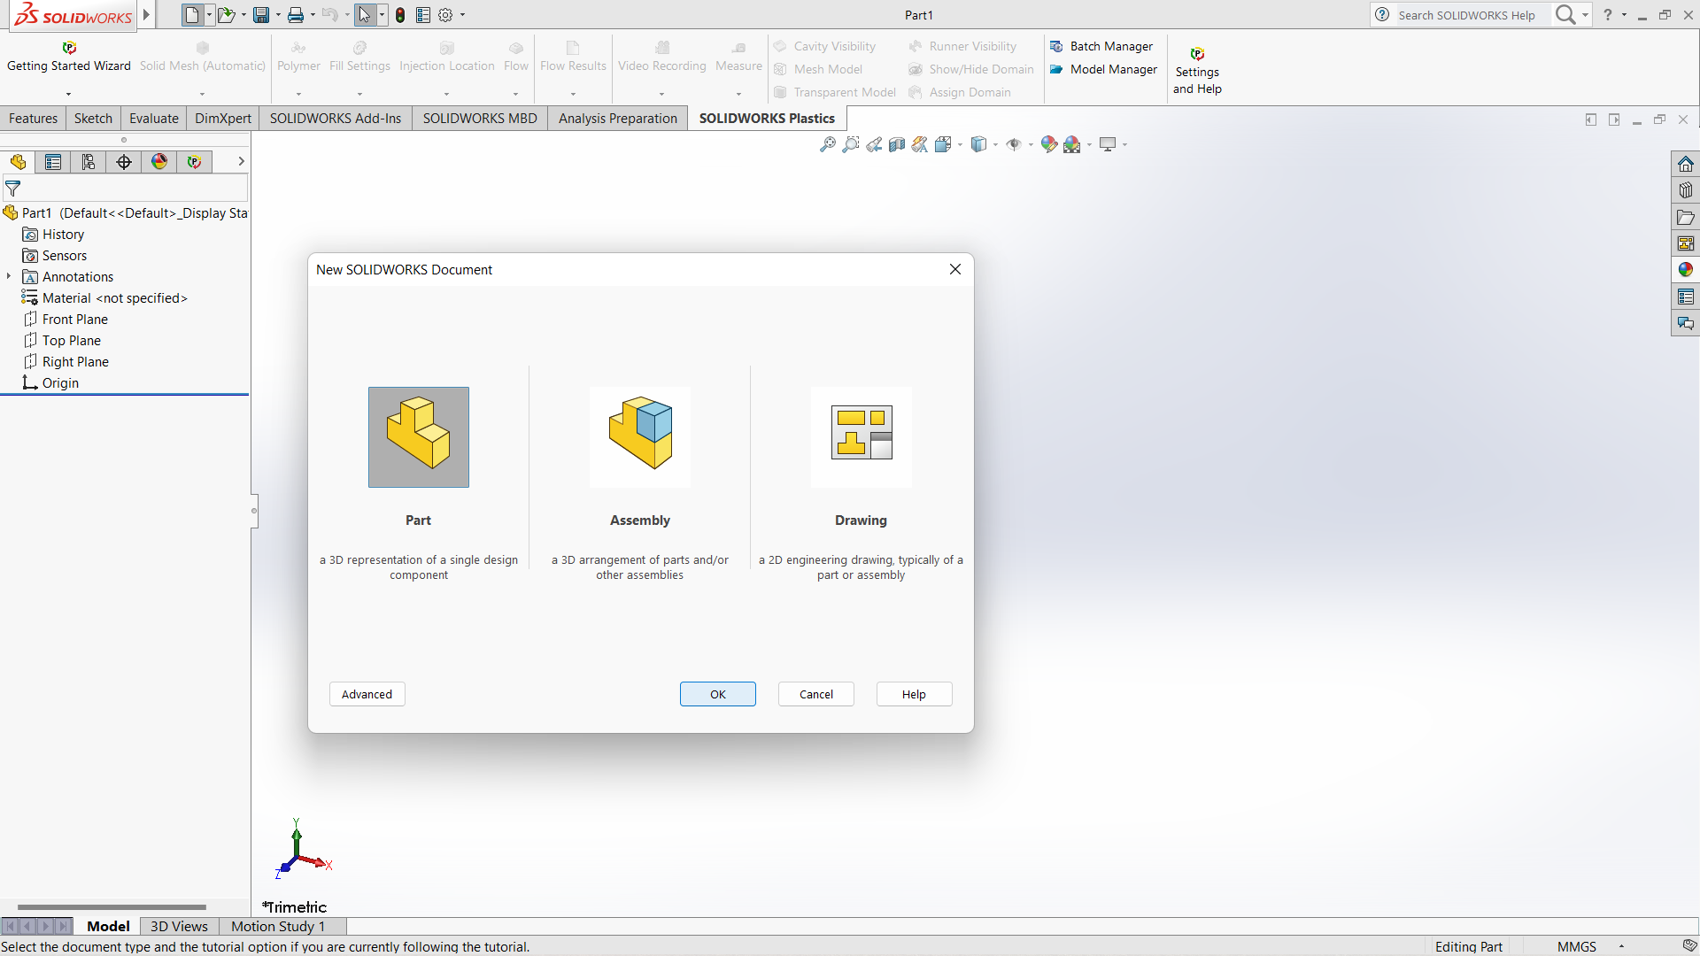

Slide 6
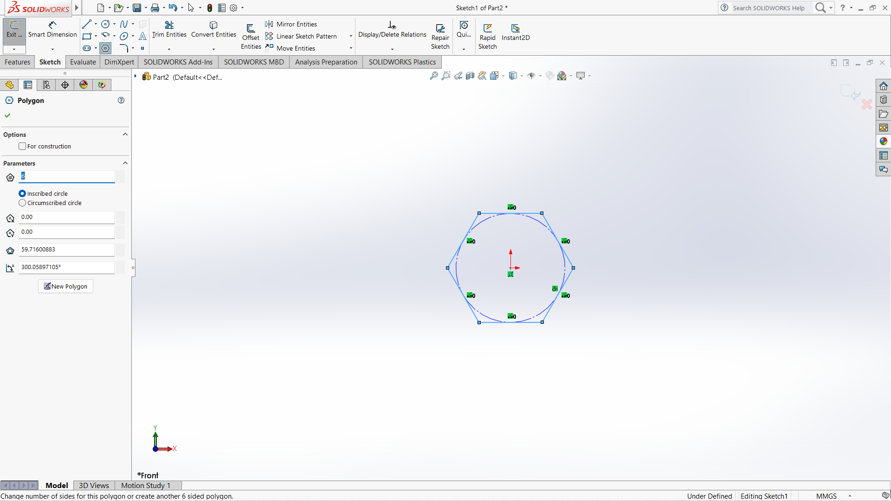

Slide 7
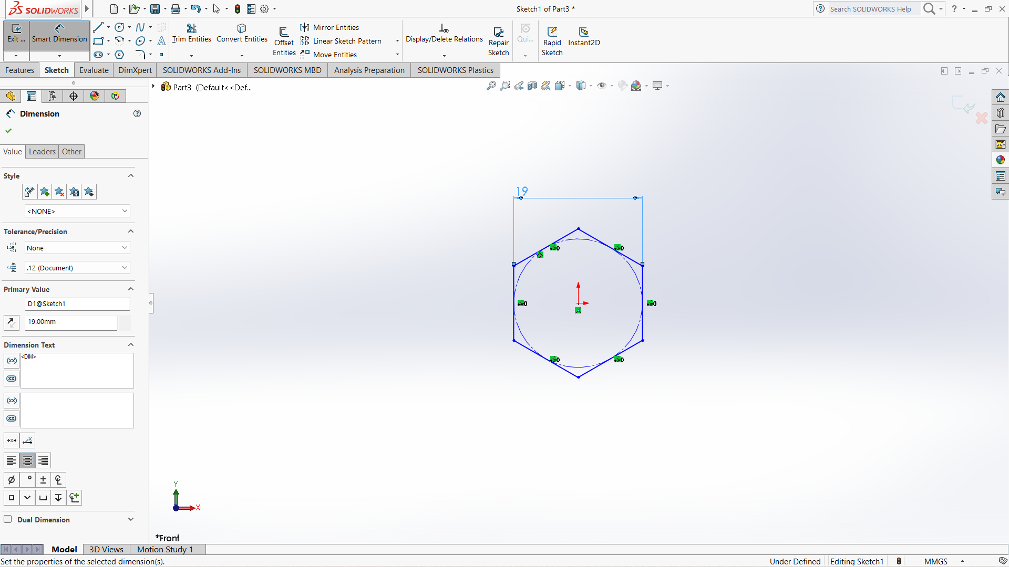

Slide 8
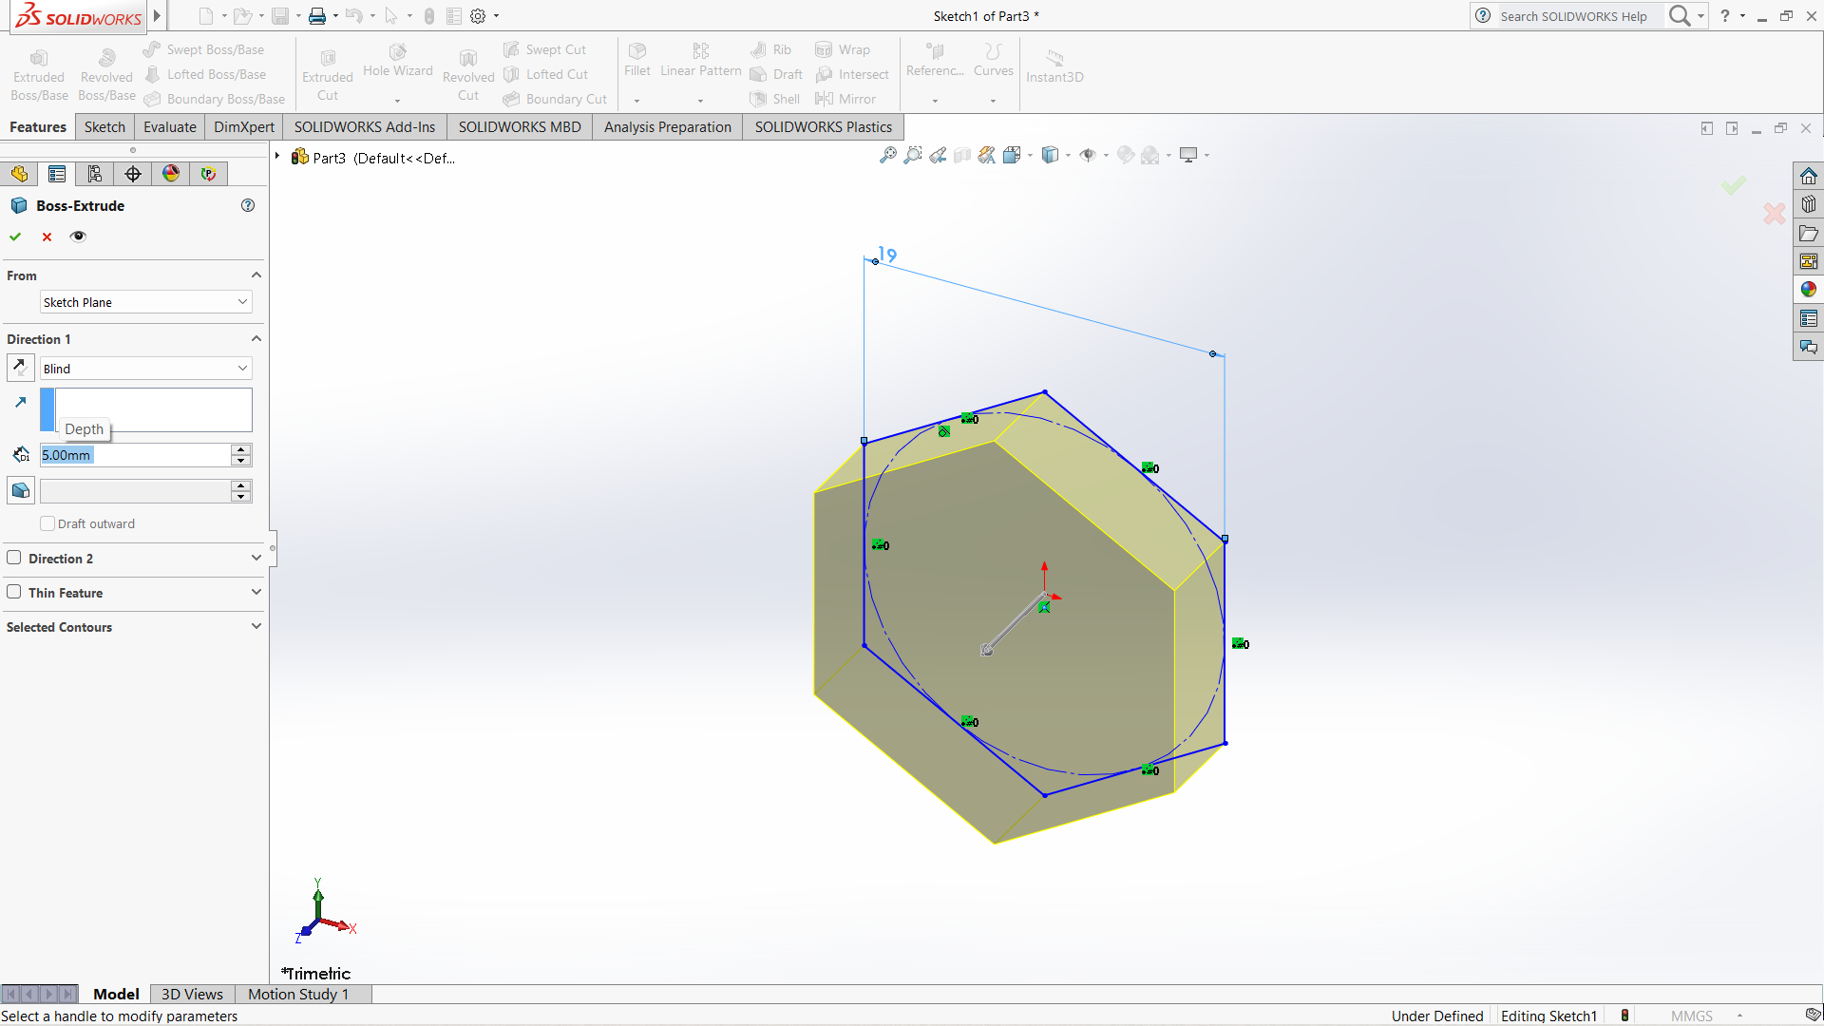

Slide 9
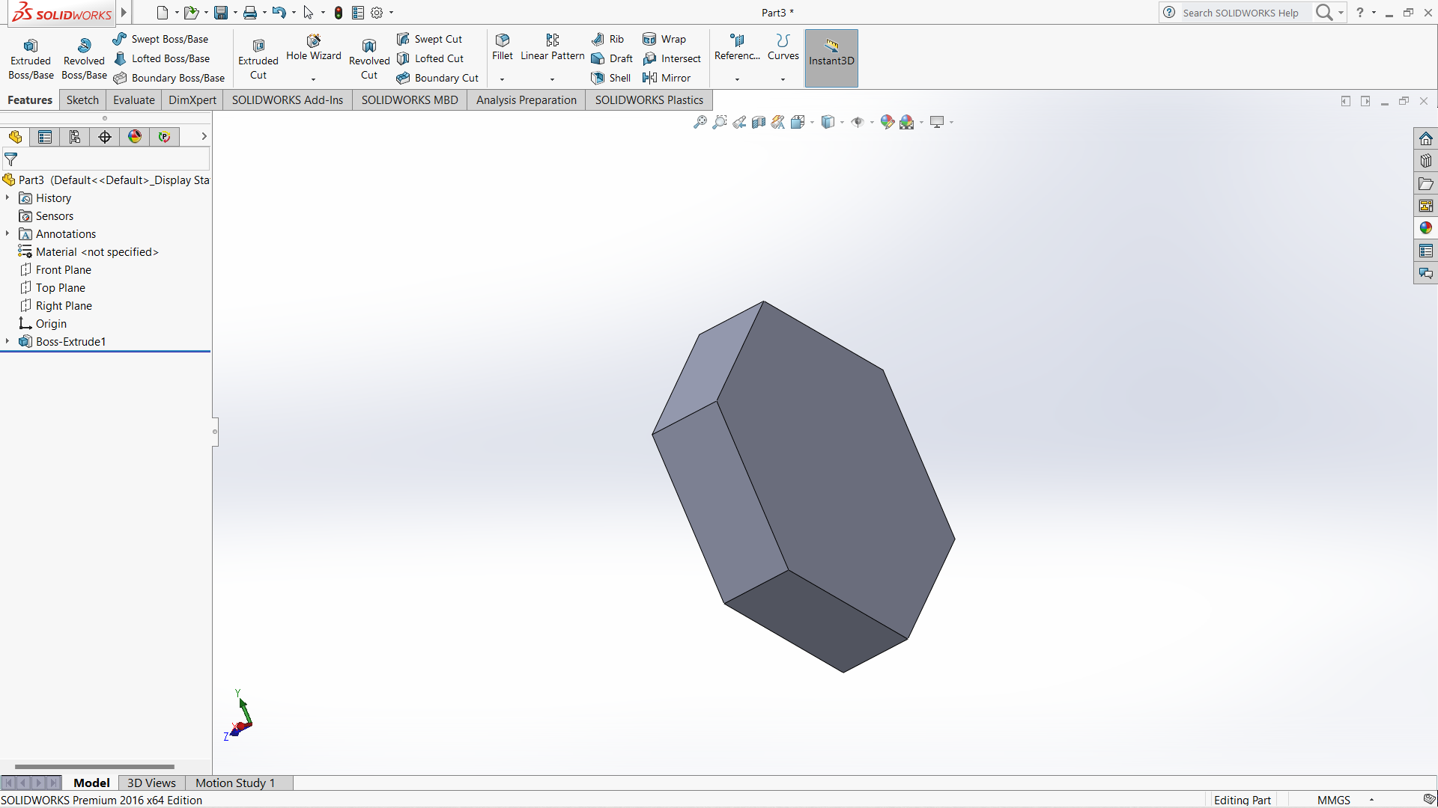

Slide 10
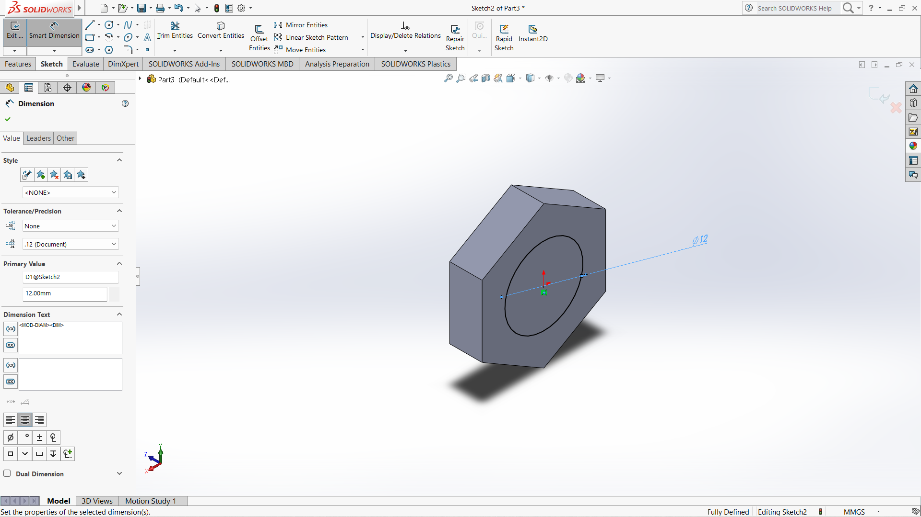

Slide 11
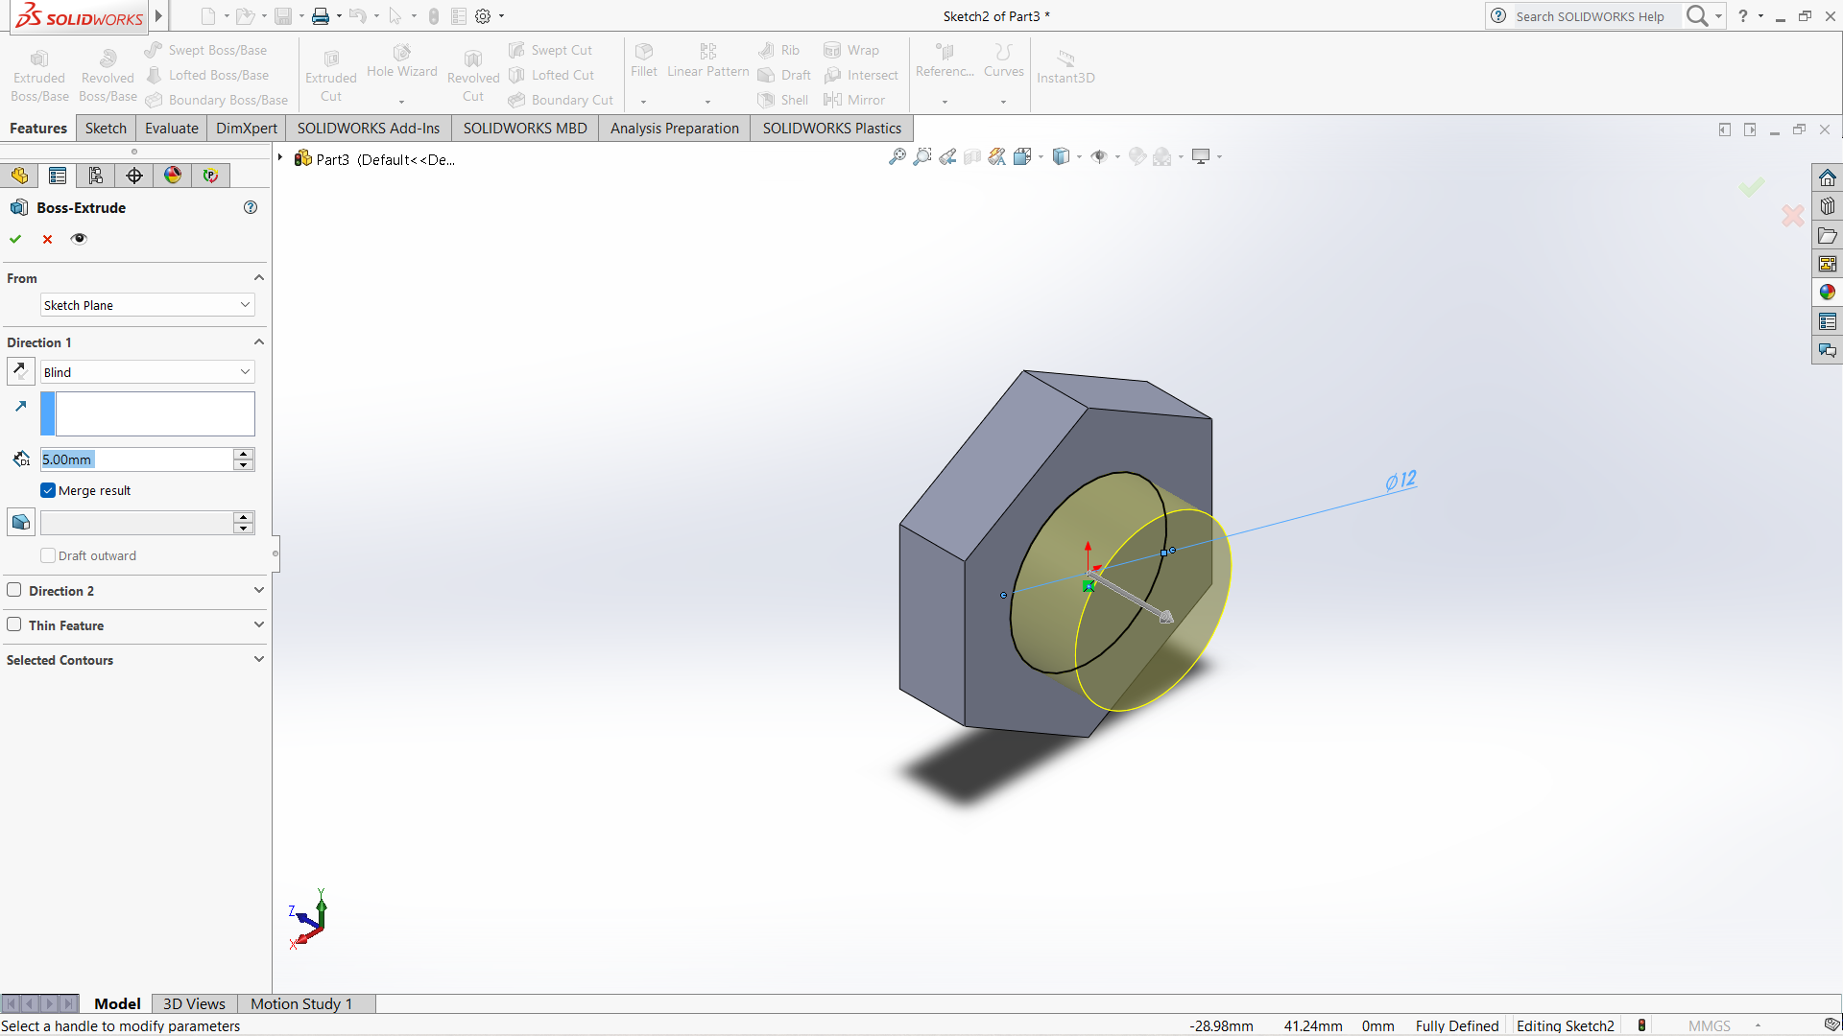

Slide 12
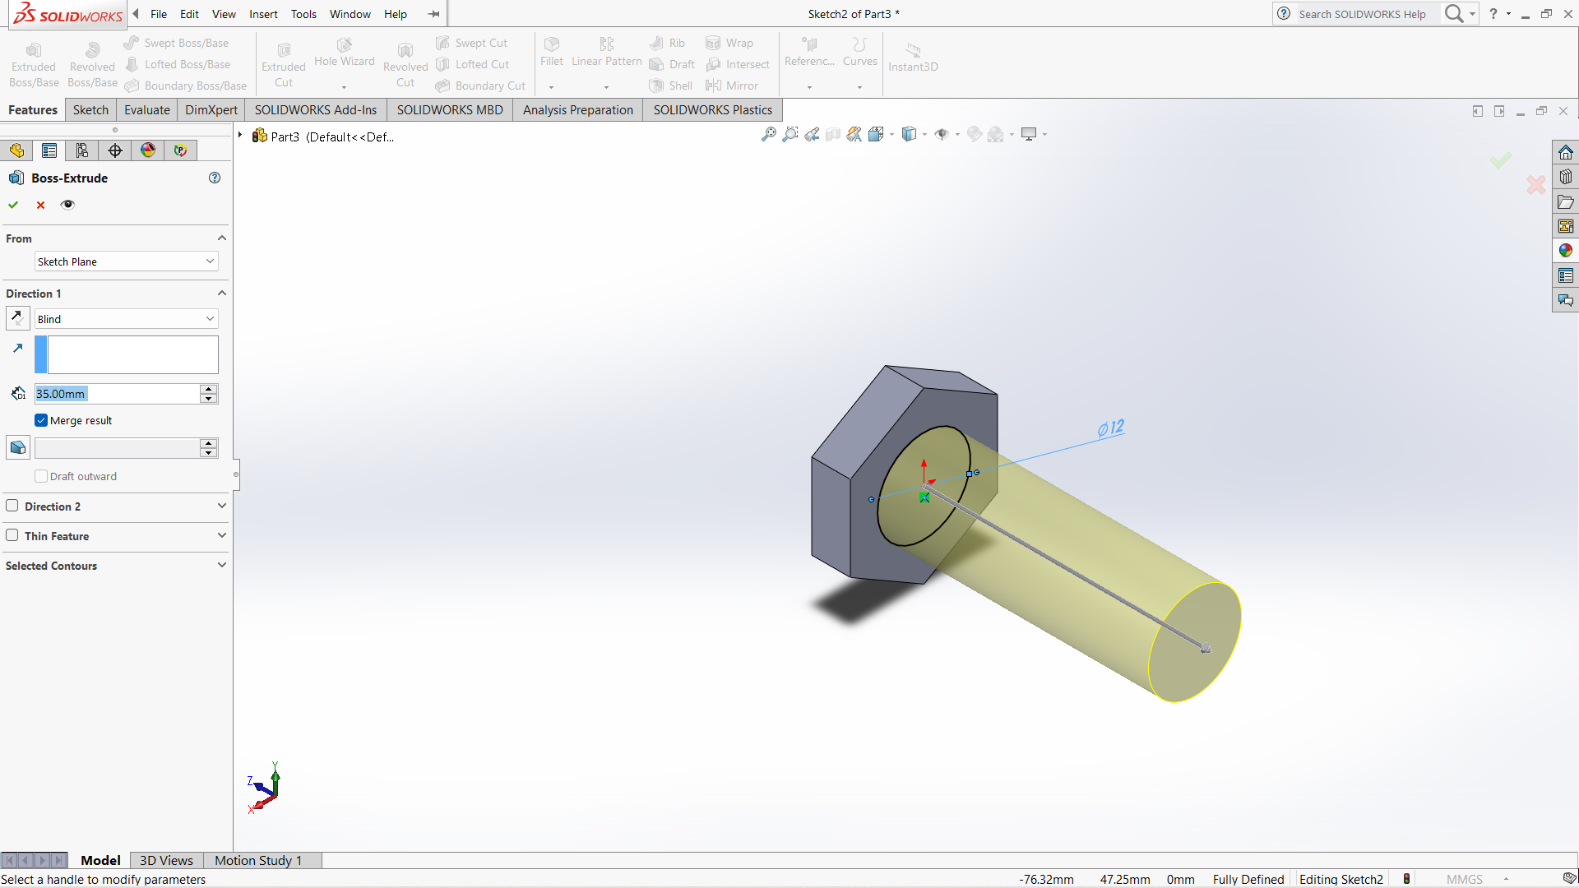

Slide 13
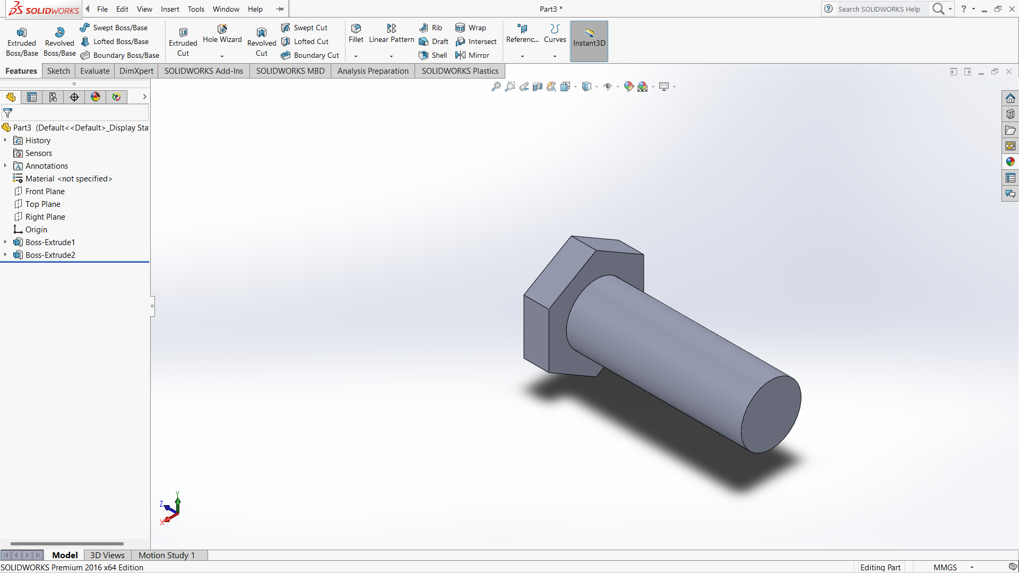

Slide 14
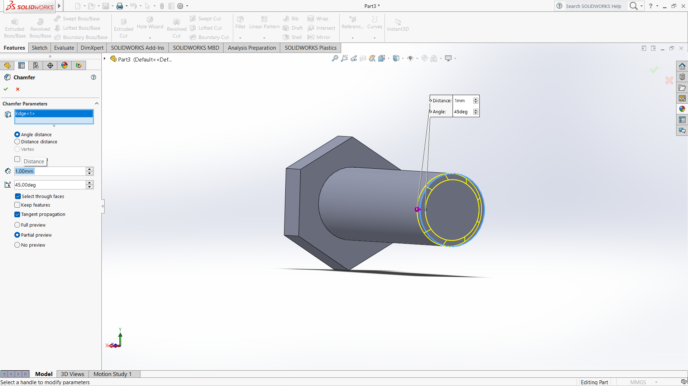

Slide 15
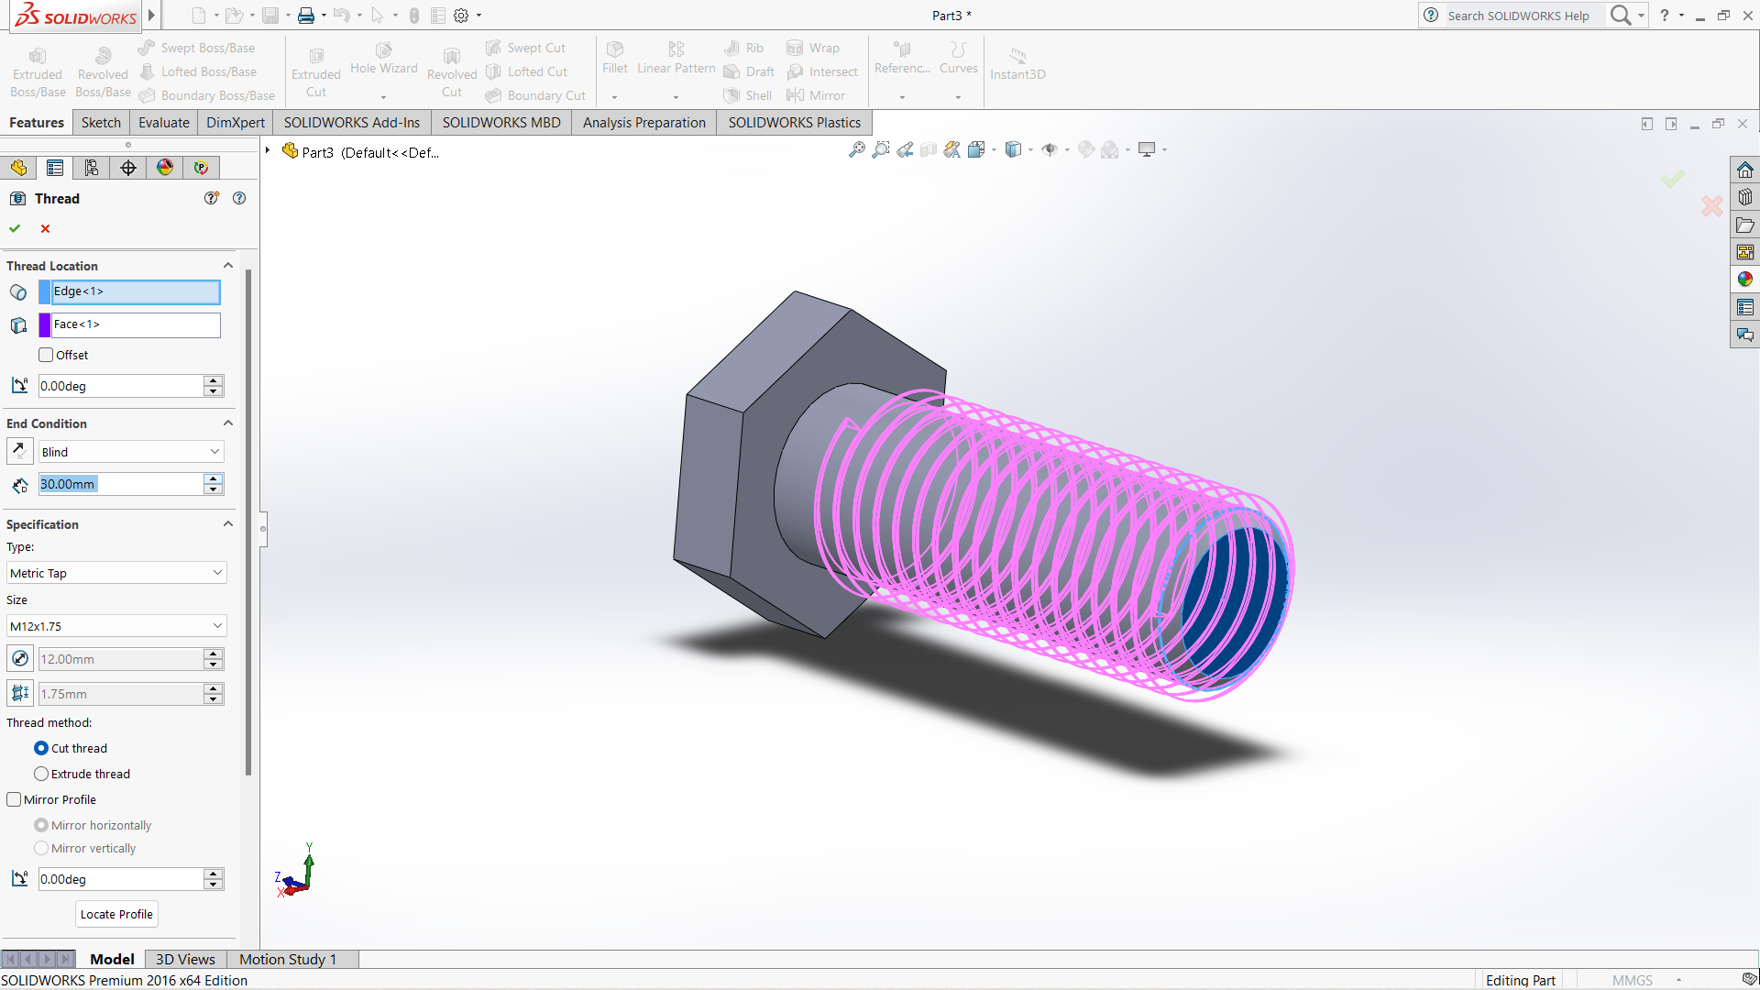

Slide 16
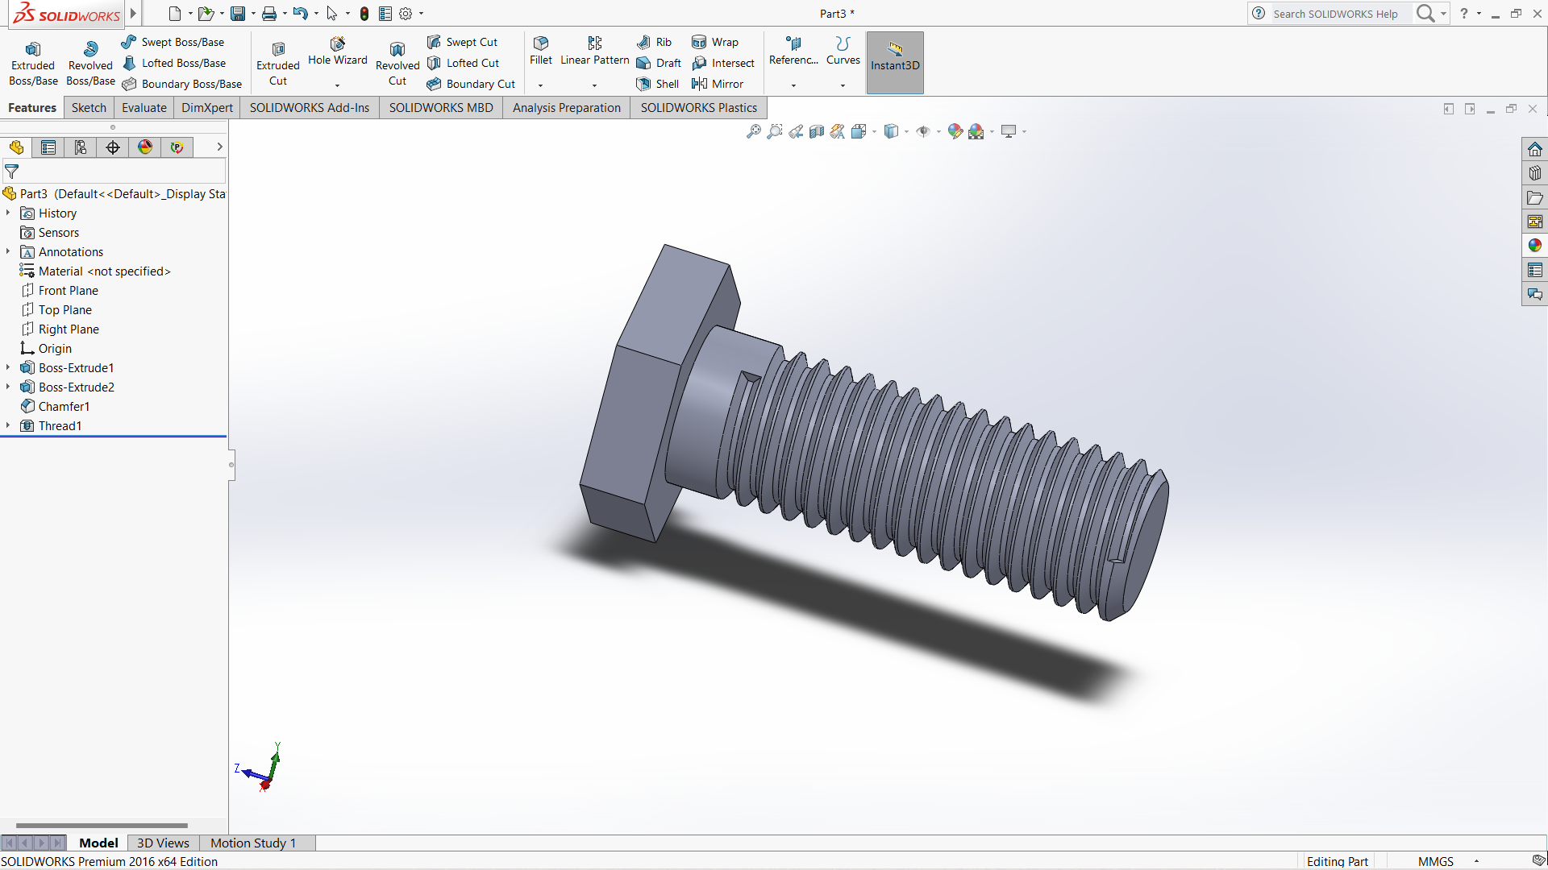

Slide 17
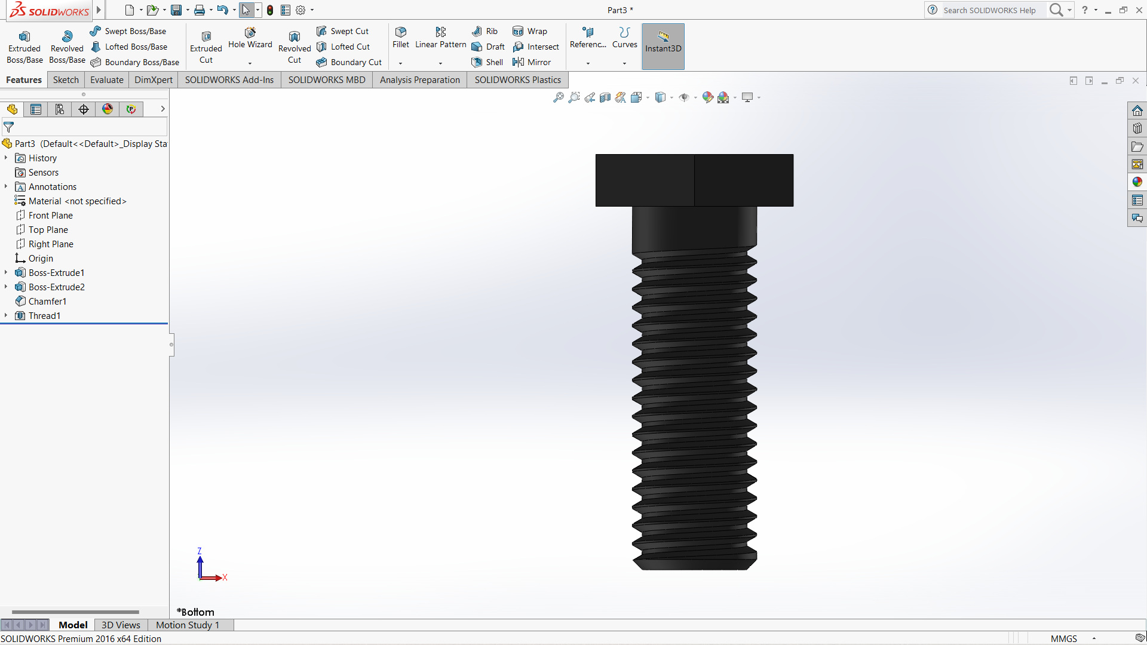

Slide 18
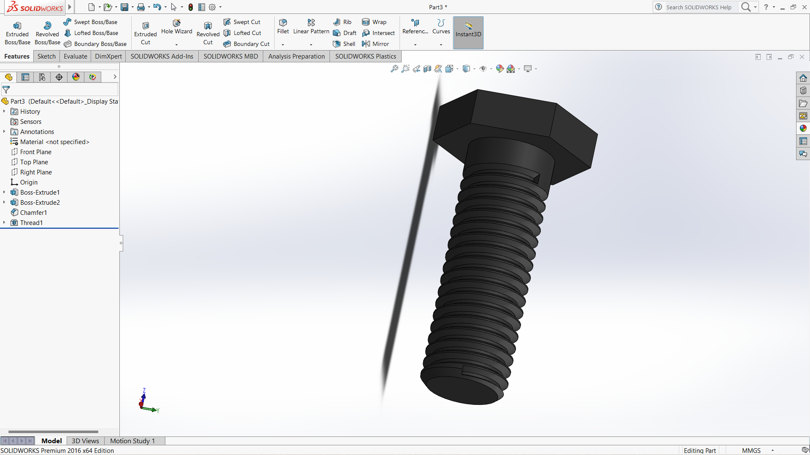

Slide 19
Thank you

